Slide 1
Human resources slide 1
MINDMATE
Team Name: Bugbusters
Topic: Health

Slide 2
Human resources slide 2
PROBLEM - STATEMENT:
Low life is a common mental disorder. Globally, more than 300 million people of all ages suffer from anxiety and depression.
Mental stress is the leading cause of disability worldwide, and is a major contributor to the overall global burden of disease.
It can cause the affected person to suffer greatly and function poorly at work, at school and in the family.
Close to 800 000 people die due to suicide every year. Suicide is the second leading cause of death in 15-29-year-olds.

Slide 3
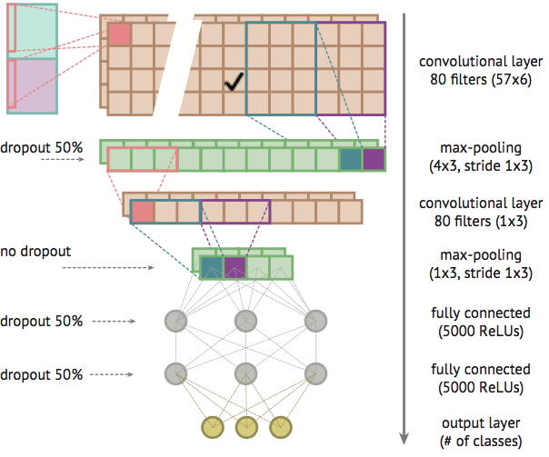
Human resources slide 8
TECHNOLOGY – STACK & ARCHITECTURE
Technology stack used
CNN Model
Deep Learning: CNN Model to detect emotion from voice.
Node.Js: Using socket.io library ,we implemented an anonymous chat-app
Android: Used many libraries including :
- Firebase(For Login System)
- Google API Client(For Google maps)

Slide 4








Human resources slide 4
OUR WORKING PROTOTYPE
OUR WORKING PROTOTYPE
MOOD AND EMOTION DETECTION USING VOICE :
+
LISTEN TO INSTRUMENTAL MUSIC :
MEMES AND GAMES TO REFRESH YOUR MOOD:
ANONYMOUS
CHAT:
BOOK AN APPOITMENT WITH A DOCTOR VIA PAYTM:

Slide 5
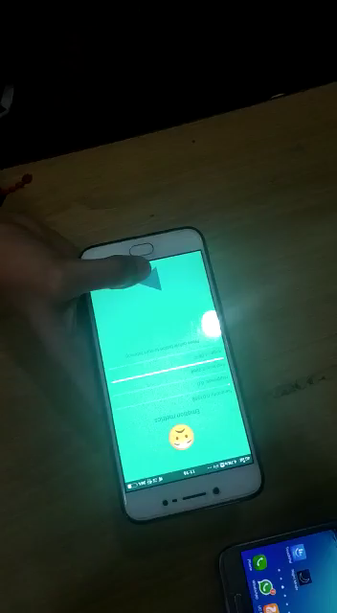
WORKING DEMO
Sadness

Slide 6
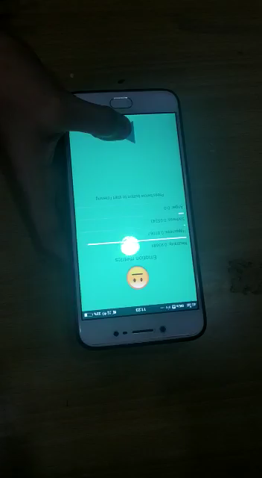
Neutral

Slide 7
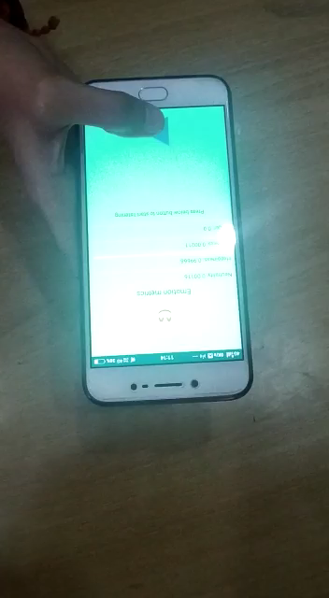
Happy

Slide 8

Human resources slide 7
BUSINESS MODEL
BASIC PLAN
PREMIUM PLAN
1st free
appointment
with Paytm
More
than
5 min
Monthly
3 free
bookings
Up to
5 min
Record up to 5 min. of free voice sample and detect your mood using our CNN model.
Book your 1st free appointment with doctor using Paytm.
Detect your mood over unrestricted sample length to get better results.
Get access to your 3 monthly free appointments with doctor using Paytm

Slide 9
Human resources slide 10
Thank You

